Slide 1
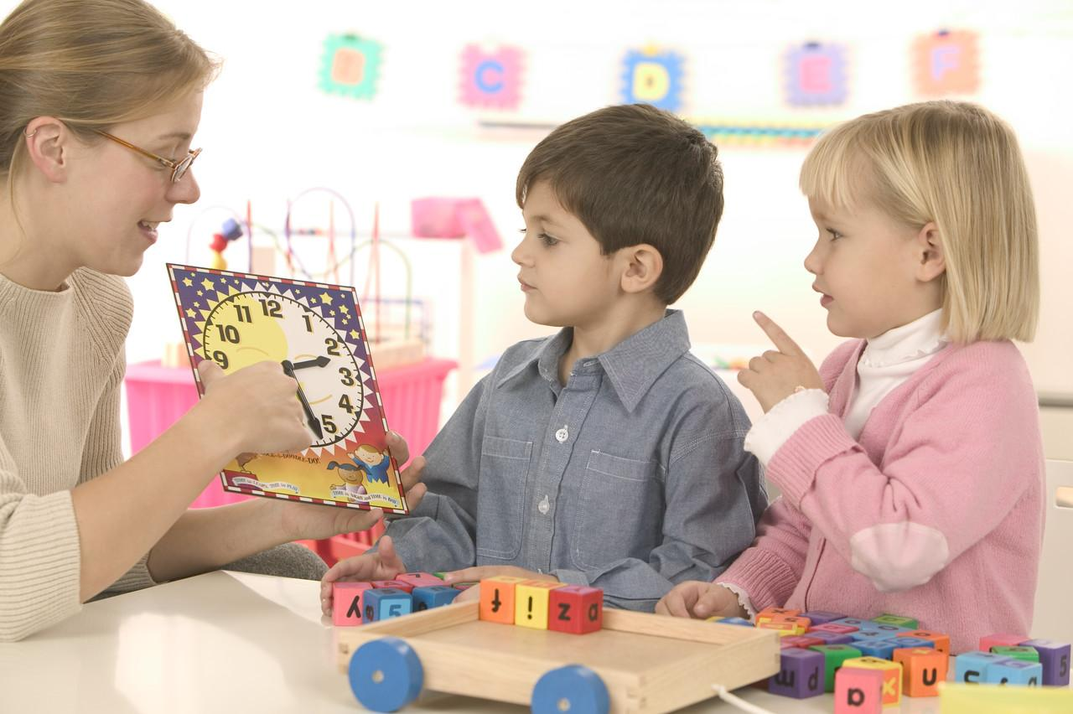
Kindergarten
Ready, Set, Go!
Buffalo Trail Public Schools is committed to maximizing student learning,
in a safe and caring environment, supported by a highly effective team.

Slide 2
Buffalo Trail Public Schools is committed to assisting our early learners in reaching emotional, social, intellectual and physical milestones and ensuring that they are ready for grade school.
BTPS understands that young children entering school have unique and varied skill sets, based on a variety of factors. BTPS provides many supports and services that are designed to increase every child’s participation in learner outcomes and to meet every child’s diverse learning profile.
Buffalo Trail Public Schools is committed to maximizing student learning,
in a safe and caring environment, supported by a highly effective team.

Slide 3
Table of Contents:
Welcome to Kindergarten (p.4)
Is My Child Eligible? How Do I Register? (p.5)
Transportation (p.6)
Is My Child Ready? (p.7)
I’m Worried My Child Isn’t Ready (p.8)
Is My Child Eligible for Early Entrance? (p.9)
Tips for Transition (p.10)
What Will My Child Learn? (p.11)
Sample Kindergarten Activities (p.12)
What is Purposeful Play? (p.13)
Kindergarten Programs in BTPS (p.14)
FAQ’s (p.15)
FREE - Eye See…Eye Learn Program (p.16)
Lunches (p.17)

Slide 4
“Kindergarten is a wonderful way for your child to discover what school is like and to have fun while learning new things.
Welcome to Kindergarten!
In a kindergarten setting, children’s natural curiosity and eagerness to learn are structured through organized activities and purposeful play.
Your child will interact, imagine, experiment and explore to add to their knowledge, learn new skills and practise what they’ve learned.” Alberta Education, Kindergarten at a Glance

Slide 5
Is My Child Eligible? To be eligible to attend in the 2021/22 school year, children must be five years old on or before December 31, 2021.
How Do I Register?
You may register your child for Kindergarten starting in January 2021. Due to the restrictions around the Covid – 19 outbreak, please contact your local school to register and make arrangements to provide the following necessary documents:
Birth certificate or Canadian Citizenship
Resident address and/or rural land location
Please note that we would love to meet you and your child in person, but due to current restrictions, our usual practices of hosting information sessions and gatherings can’t take place at this time.
Registration: http://www.btps.ca/
Registration.php
Don’t forget about transportation..

Slide 6
Transportation
You can register for Transportation services in 3 ways:
*Call the BTPS Transportation Office at 780-806-2052
*email transportation@btps.ca
*visit the BTPS website https://sites.google.com/a/btps.ca/btps-transportation-registrations/
Advanced notice of transportation needs are appreciated as it assists in efficient planning of bus routes for the upcoming school year.
For more information regarding transportation regulations and fees, and to find out about bus cancellations and inclement weather policies, please visit http://www.btps.ca/Section%207.php .

Slide 7
Is My Child Ready?
Kindergarten is the start of an exciting adventure for
your child. Though your child does not have to have any
specific knowledge or skills to begin, it is helpful if they can:
Toilet and Wash Up
Share and Take Turns
Listen and Pay Attention for Short Times
Dress and Undress Self
Speak and Ask for What They Need
Cooperate and Play Well With Others
Inspired by www.dsbn.org/kindergarten.gettingready.html

Slide 8
I’m Worried My Child Isn’t Ready
Children develop at different rates, so you may choose to enroll your child in the first year they are eligible for kindergarten, or wait until they are already 5 when they start kindergarten.
The following resources can help you make your decision:
Local School:
Talk to your school’s kindergarten teacher about your concerns.
Ages and Stages Questionnaire:
The “Ages and Stages” developmental questionnaire looks at your child’s complete development: intellectual, social, fine motor, personal, and communication abilities are assessed and the questionnaire is an excellent tool to help you determine if your child is ready for kindergarten.
You can access the questionnaire by calling The Wainwright and District Family Resource Network at (780) 842 - 2555
Alberta Health Services:
Attend a local walk in clinic with your child and discuss concerns you have with a speech/language pathologist, physical therapist, or occupational therapist.

Slide 9
Is My Child Eligible for Early Entrance?
Some young children are eligible for early entrance/ early intervention
programming, which is available through each Kindergarten site. It is only available specifically to children with assessed:
*severe developmental delays from 2.8 to 4.8 years of age
*mild/moderate developmental delays from 3.8 to 6.0 years of age
Early entrance and early intervention programming offers opportunities for full, balanced development of a child’s abilities, AND maximizes a child’s enjoyment and participation in the educational setting, and future school experiences. Placement of the intervention program is either a play/pre-school setting or kindergarten setting.
For more information, please contact the Department of Inclusive Learning 780-806-2046.

Slide 10
Tips for Transition:
You can help your child prepare for a new kindergarten experience:
Encourage your child to be independent. Encourage them to dress themselves, use the bathroom on their own, pick up after themselves, and help out in small ways around the house.
Develop routines for bedtimes and mornings. Five year olds need approximately 10-12 hours of sleep each night. As well, dealing with backpacks, lunches, library books, and cold weather clothing will be a daily occurrence and will take some practice to complete in a timely manner.
Give your child opportunities to make choices and solve problems. Encourage your child to express what they want/need or take a moment to “figure something out ” on their own.
Talk about school in a positive manner and help your child feel excited about their new experience. Purchase any school supplies needed before your first day of kindergarten.
Take your child to the school and playground before school starts so it becomes familiar to them. Attend the kindergarten information evening at your school, ask for a school tour or time when you could meet the bus driver.
Provide your child with a well balanced diet and opportunities for daily indoor and outdoor play and exercise.
inspired by cbe.ab.ca/earlylearning

Slide 11
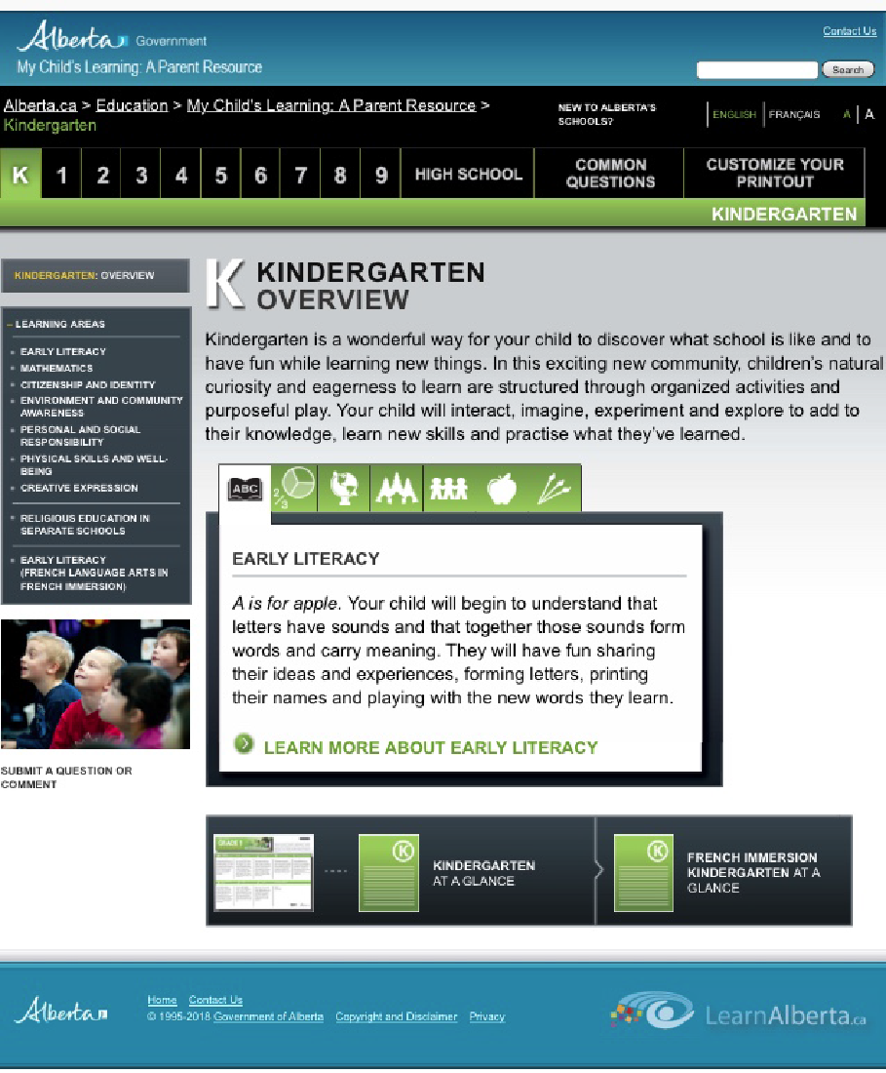
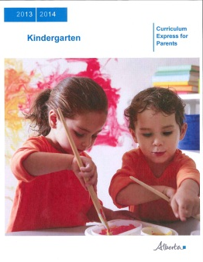
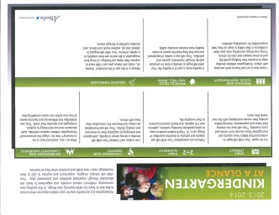
What Will My Child Learn?
The skills your child will learn in Kindergarten are called Kindergarten Learner Outcomes and below is a list of documents that best explain them. Or, visit the Alberta Education Website at www.learnalberta.ca for a complete listing of resources regarding Kindergarten.
My Child’s Learning: A Parent Resource: LearnAlberta.ca
Kindergarten Program Statement: Education.Alberta.ca
Kindergarten At A Glance: Learn Alberta.ca

Slide 12
Sample Kindergarten Activities:
Your child’s kindergarten day includes both organized activities and purposeful play. The following skills may be encountered by your child in kindergarten. Why not try a few at home!
Put a puzzle together.
Use blocks or Lego to build a tower.
Colour a picture.
Draw a picture.
Print first name.
Trace different shapes.
Cut pictures out of magazines.
Cut out shapes.
Count 10 stairs as you walk up them.
Count out 10 nickels or marbles.
Sing nursery rhymes.
Sing the ABC song.
Read story books.
Hop, skip, gallop or walk backwards.
Play a board or card game to practice taking turns.

Slide 13
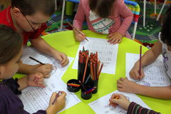
What is Purposeful Play?
“Play expands intelligence, stimulates the imagination, encourages creative problem solving, and helps develop confidence, self-esteem and a positive attitude towards learning.”
Dr. Fraser Mustard
Research shows us that play and academic work are not separate categories for young children. When children are manipulating objects, acting out roles or experimenting with different materials they are constructing, challenging and expanding their own understanding. Being playful is a child’s natural state and is the most preferred, efficient way of garnering information. Kindergarten educators in BTPS intentionally plan and create purposeful play activities that promote the healthy development of young children.
inspired by CMEC Statement on Play-Based Learning

Slide 14
Kindergarten Programs:
School | Days/Times | Contact Info
APPLE Centre - Amisk | Tuesday/Thursday (full year) Wednesday (Feb-June) | 780-856-3771
Clandonald School - Clandonald | Private ECS Operator | 780-853-2122
Dewberry School - Dewberry | Private ECS Operator | 780-847-3051
Dr. Folkins Community School - Chauvin | Monday/Wednesday (Sept-Dec) Mon/Wed/Fri (Jan-June) | 780-858-3744
EH Walter – Paradise Valley | Tuesday/Thursday (Sept - Dec) Tues/Wed/Thurs (Jan-June) | 780-745-2277
Edgerton School - Edgerton | Tuesday/Thursday (Sept - Dec) Mon/Wed/Fri (Jan-June) | 780-755-3810
Innisfree Delnorte School - Innisfree | Private ECS Operator | 592-3963
Irma School - Irma | Monday/Wednesday (full year) Friday (Feb-June) | 780-754-3746
Kitscoty Elementary School - Kitscoty | Private ECS Operator | 780-846-2822
Mannville School -Mannville | Tuesday/Thursday (full year) Friday (Dec-June) | 780-763-3615
Marwayne Jubilee School - Marwayne | Monday/Wednesday (full year) Alternate Fridays | 780-847-3930
Provost Public School - Provost | M/W (full year) Friday (Jan-June) | 780-753-6824
Vermilion Elementary School -Vermilion | A) T/Th alternate F (full year) B) M/W alternate F (full year) | 780-853-5444
Wainwright Elementary School - Wainwright | A) T/Th alternate F (full year) B) M/W alternate F (full year) c) T/Th alternate F (full year) | 780-842-3361

Slide 15
Frequently Asked Questions (FAQ’s):
Age Requirement?
Your child must be five years of age by December 31 of the school year.
Program Times?
Kindergartens follow the regular BTPS school calendar. Children receive 475 hours of instruction starting in September and ending in June. Programs are full day programs 2-3 times per week, and those days vary from site to site. See page 14 for more details.
What will be learned?
Kindergarten follows a curriculum designed and approved by Alberta Education. Educators in BTPS use a common report card, and classrooms offer enriching opportunities in both structured activities and purposeful play. See pg. 11 for more information.
Should my child attend Kindergarten?
Yes, it is advantageous for a child to attend kindergarten. Early learning experiences enhance overall development and children who attend are better able to make transitions to a grade one setting.
Is the school ready for my child?
You can be confident that the school will build on all the important learning that you have helped your child achieve. Your child will be welcomed into the classroom as a unique individual, as schools are prepared to support children with different skill levels, experiences and diverse backgrounds.
Costs?
Many schools in BTPS charge school fees and they vary from site to site. Please check with your local school. As well, there may be some cost associated with bussing for some children.
Parent’s Role?
Research shows that the children of parents who get involved in the school, learn better. Parents are encouraged to connect with schools by volunteering their time in the classroom, at activities such as field trips, attending parent teacher conferences or joining parent councils.

Slide 16
Eye See…Eye Learn Program

Slide 17
Lunches for Young Children
BTPS schools are allergy aware schools, please contact your local school for any restrictions that may exist, or if your child has allergies that the school needs to be aware of.
Young children have small stomachs and need to eat small regular meals and snacks throughout the day. Pack a variety of food from each food group in small ready-to-eat amounts, and packages. Mini muffins, cheese cubes, grapes, carrot sticks, cherry tomatoes are great.
Young children are strongly influenced by how food looks. Using foods in different colours or shapes can be very appealing. Try mixing fruits of different colours or cutting cheese or sandwiches with cookie cutters.
Get your child involved by giving them choices when it comes to lunches. Create a homemade snack mix of crackers, cereal, dried fruit and pretzels or let them choose what kind of bread or filling for their sandwich. Having them help prepare and pack the lunch leads to good eating habits that will follow them the rest of their life.
Occasionally pack a surprise! Who doesn’t like a smiley face drawn on a banana or a little note saying I love you!
The option to heat a lunch in a microwave may not be available for Kindergarten students. Please ask your child’s teacher before sending a lunch that needs heating.
There are many websites and cookbooks dedicated to school lunch ideas, that can help you think of different ways to keep your child interested in eating healthy.
Inspired by Alberta Health and Wellness – Healthy Eating and Active Living

Slide 18
Welcome to our School Family!
For further information regarding programming, please contact us at
(780) 842 - 6144

